Slide 1
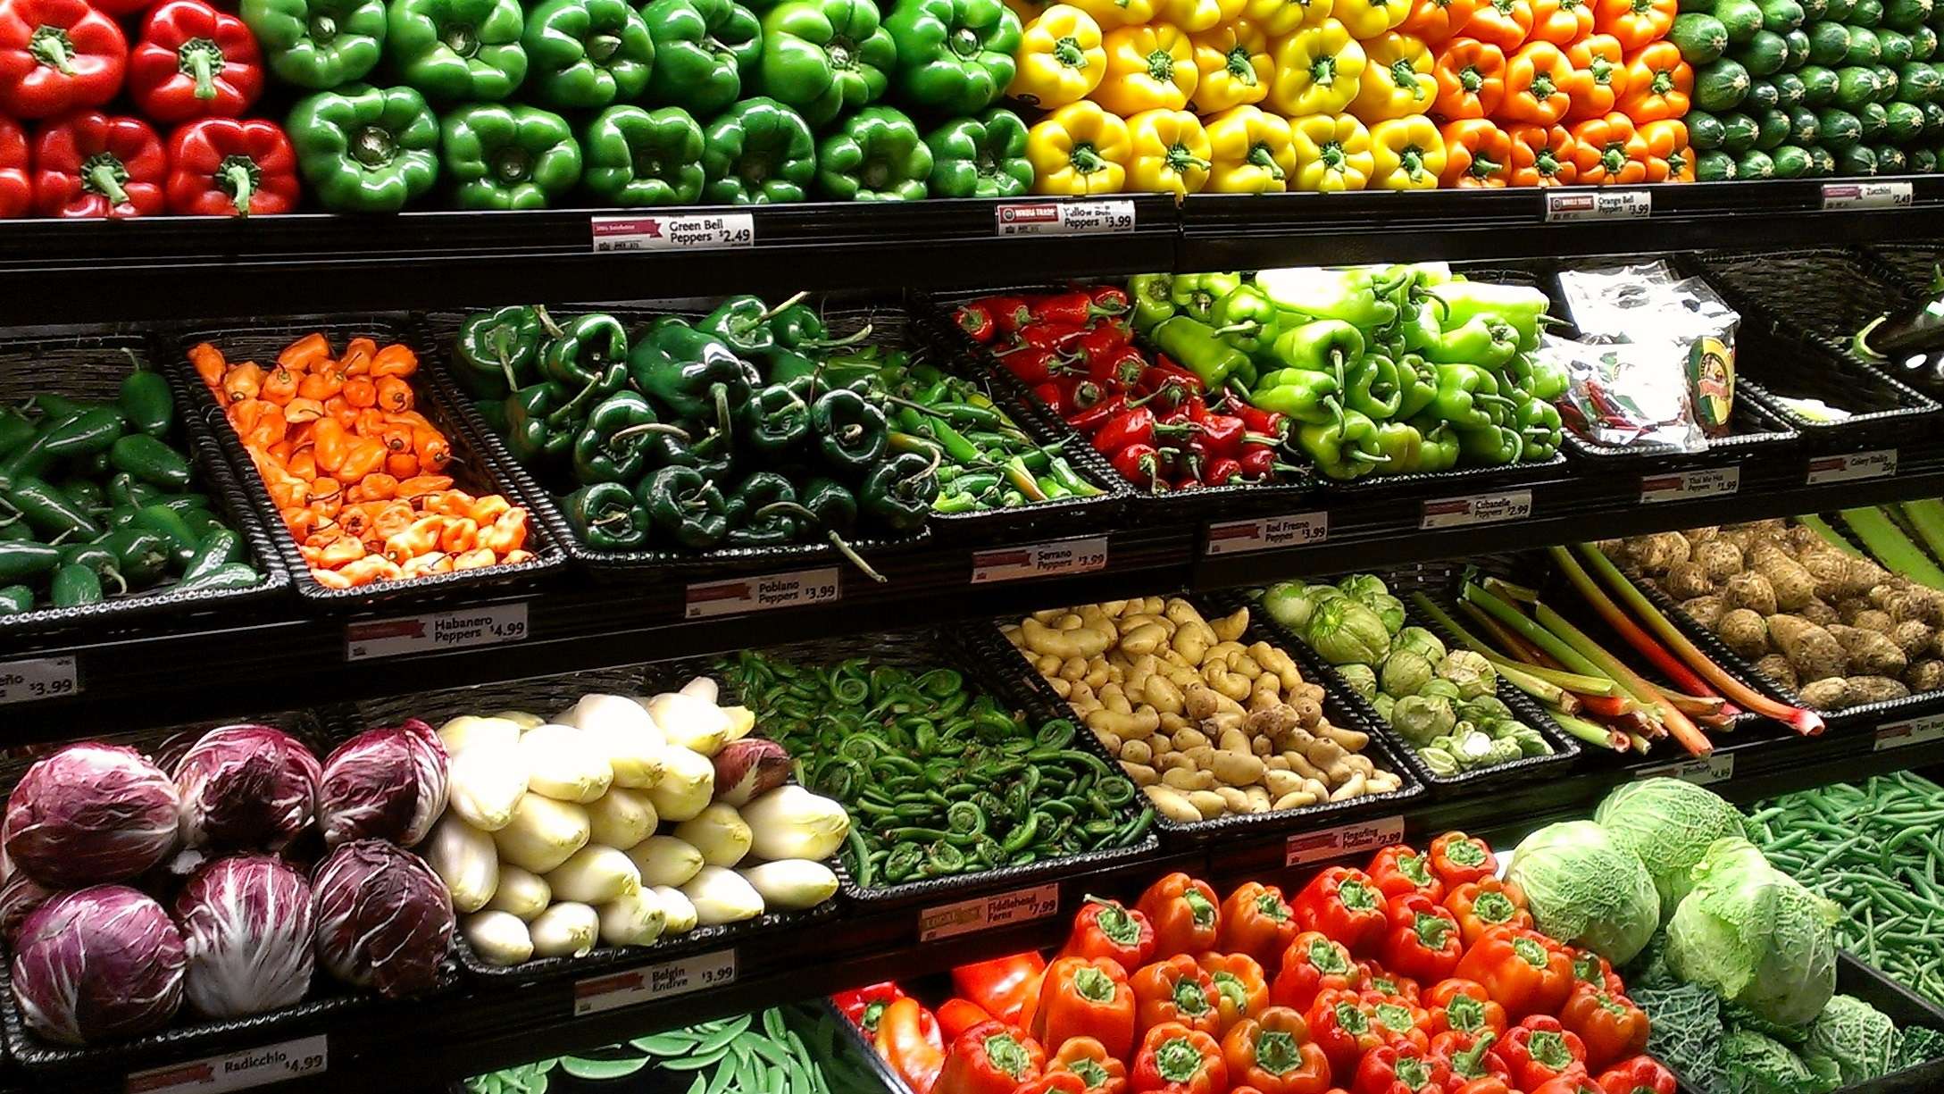
ONLINE MARKET PLACE FOR ORGANIC FOODS USING BLOCKCHAIN TECHNOLOGY
Project ID : 19_20-J 06

Slide 2
OUR TEAM
Supervisor: Dr. Dharshana Kasthurirathna
Co-Supervisor: Mr. Prasan Yapa
H.D.M. Perera IT16122956
D.K.G.S.H. Liyanage IT16175358
D.S.M. Mallikarachchi IT16235298
A.W.M.J.S. Bandara IT15145994

Slide 3
INTRODUCTION
This research idea is base on how Products are delivered to customers by considering all related details beginning from manufacturer to customer using blockchain technology
Throughout the research we will be considering the below listed components
Storing Supply Chain Details using Blockchain Technology
Choose the Optimal Path for Delivery
Analysis of Product Reviews to Detect fake and Spam Reviews
Sentiment Analysis using Reviewed Comments

Slide 4
LITERATURE
Most of the countries have implemented supply chain management systems in order to deliver fresh organic foods and to make an efficient delivery while avoiding the unnecessary traffic congestion.
In Australia they have implemented Wine Supply Chain Traceability System using Blockchain

Slide 5
RESEARCH GAP
Most of the time other researches only focuses on one feature but we consider to develop a full web application with all features to
Mainly, the supply chain is trace to find and handled any the source of illegal activities such as fake commodities, illegal labor and money launderings.
The proposed application will provide the users to buy fresh organic foods and a very well optimized delivery route to the destination. Since three factors Time, destination, cost are considered in the application, most efficient route will be predicted to the user.

Slide 6
RESEARCH PROBLEM
Food products that are unsuitable for human consumption has been a severe problem in the fast-moving society. Due to the less advanced food supply system which is in use the current transportation system has been inefficient.
This research will mainly focus on below listed research problems.
Difficulties in identifying the whole supply chain process and process is transparent and reliable to the customer
Difficulties in choosing the optimal delivery Route.
Difficulties in identifying fake and spam reviews provided for products by customers
Accuracy problems in Sentiment Analysis

Slide 7
PROPOSED SOLUTION
Our solution is to develop a web application in order to record supply chain related details beginning from manufacturer to customer using blockchain technology in order to reduce intermediaries throughout the supply chain process.
Furthermore, customers able to scan the QR codes stick on the products which redirect to a web page which holds product’s supply chain details.
Customers can comment on products and System will be detect which comments are legal or fake provided by users and Fake comments will be capitalized.
And according to legal comments, a review is provided on those comments by using “Sentiment Analysis”.

Slide 8
MAIN OBJECTIVE
To find fresh and organic food products with ease by ensuring that all steps from food production to delivering it to the customer are transparent and reliable.

Slide 9
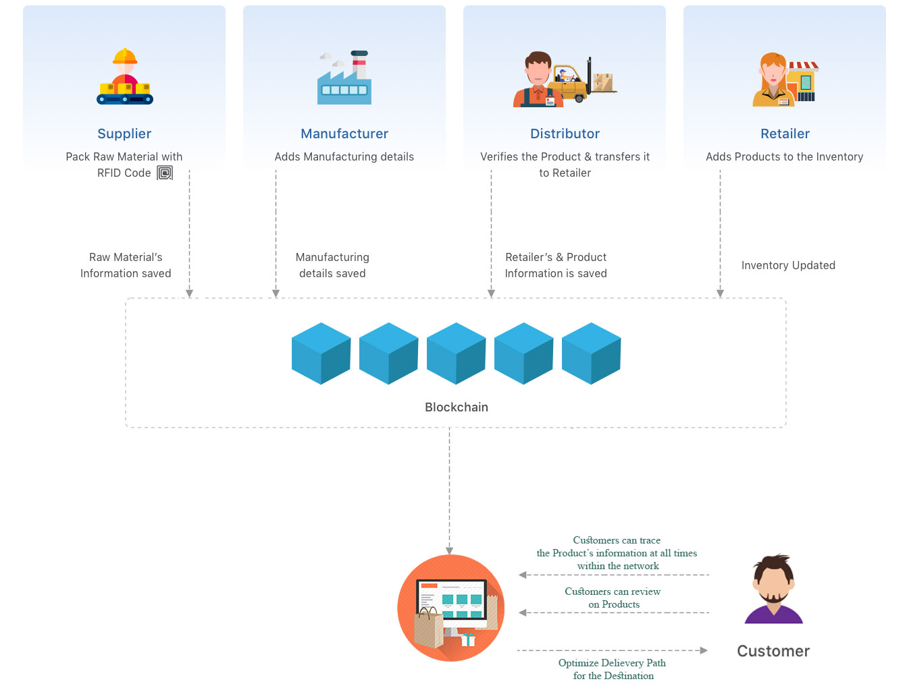
SYSTEM ARCHITECTURE

Slide 10
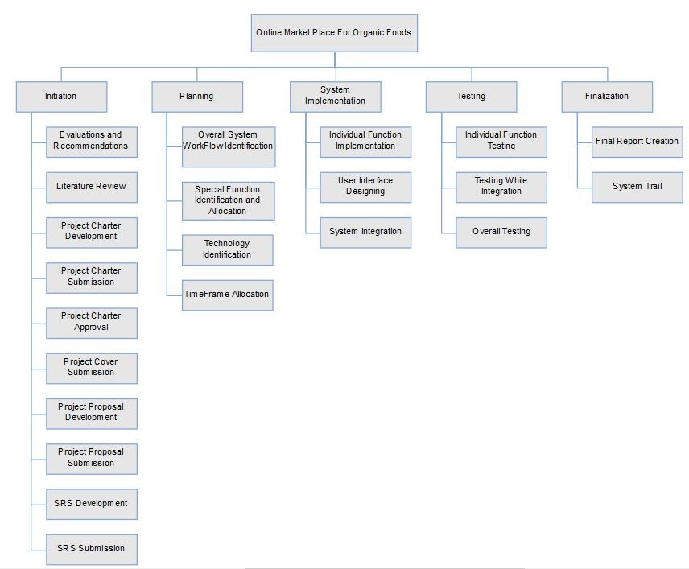
WORK BREAKDOWN STRUCTURE

Slide 11
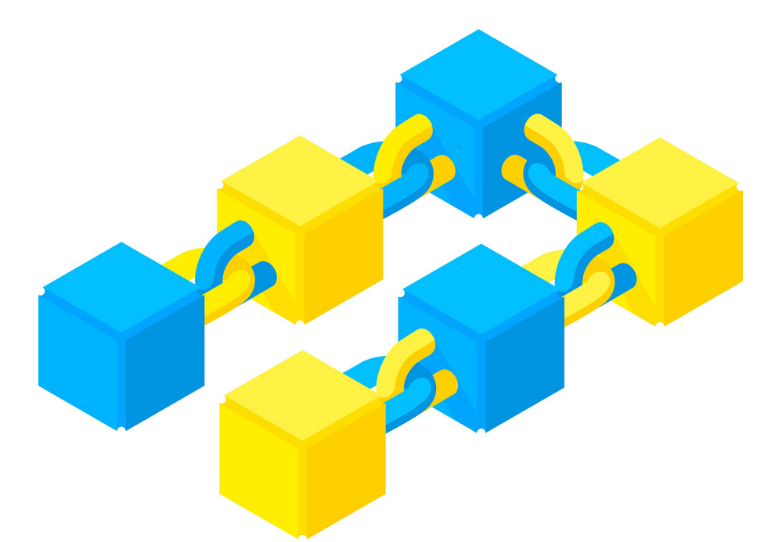



INDIVIDUAL COMPONENTS
Storing Supply Chain Details using Blockchain
Choose the Optimal Path for Delivery
Analysis of Product Reviews to Detect fake and Spam Reviews
Sentiment Analysis using Reviewed Comments

Slide 12
Storing Supply Chain Details using Blockchain
Main functionality in this segment would be focused around the process of acquiring and delivering/ distributing goods. Initially as soon as the produce is obtained from the farmers, the blockchain process begins in storing details relevant to the product. Once the produce is obtained, pertaining to the needs, respective manufacturers would receive the ingredients/ material. Important dates and details would further be appended to the blockchain and be received by the suppliers. From suppliers, the products manufactured would be distributed across all supply channels with retailers handling the end node of the blockchain process till customers interact with advertised products. The blockchain would further act as the unchangeable data storage for each product throughout its entire lifecycle in this business logic.

Slide 13
Choose the Optimal Path for Delivery
Once orders have been placed, to ensure minimal deterioration of quality occurs, the most efficient and optimal path has to be detected by the delivery navigation process. This would refer to many constraints such as time, distance, fuel costs etc. in determining the best route possible to reach a customer as quickly as possible using a continuous variable adaptive real time navigation process which takes not only geographical features but also traffic and road conditions etc. into account as well.

Slide 14
Analysis of Product Reviews to Detect fake and Spam Reviews
The consumers and general users are capable of submitting objective reviews in forms of comments as feedback to improve the system capabilities and handle malfunctions. This poses a potential risk in accumulating and accounting up for spam and fake reviews from sabotage oriented competitive strategies as well as general customers. To analyze the authenticity customer catalogs would have to be accessed and compared against comment users of suspect reviews. Detecting these spam and fake comments would ensure that the review related product rating stays relevant and accurate.

Slide 15
Sentiment Analysis using Reviewed Comments
Using the ontology model proposed, the content of user reviews would be filtered according to respective domains required by the standards of final rating required for a particular product. This requires product review comments to be dissected utilizing semantic analysis-based approaches while providing a rating spectrum as expressed previously in the literature study.

Slide 16
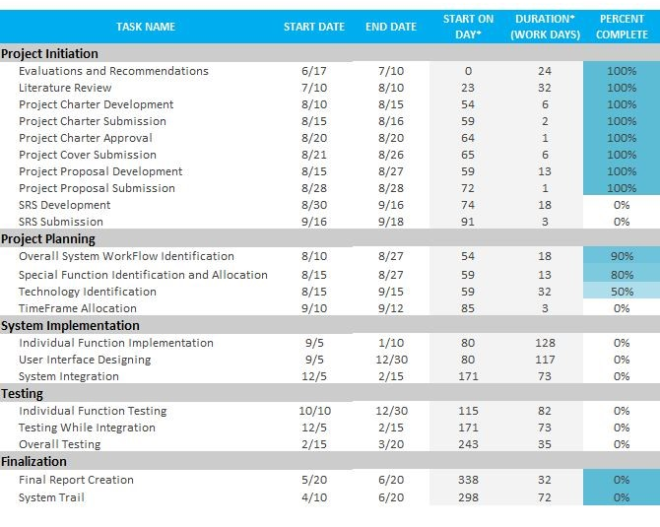
PROJECT TIME ALLOCATION

Slide 17
THANK YOU!

